Slide 1
Conway's Game of Life
Hemanth Kumar Reddy
Shyam

Slide 2
We have…
1. Pattern Grids
2. Random Population

Slide 3
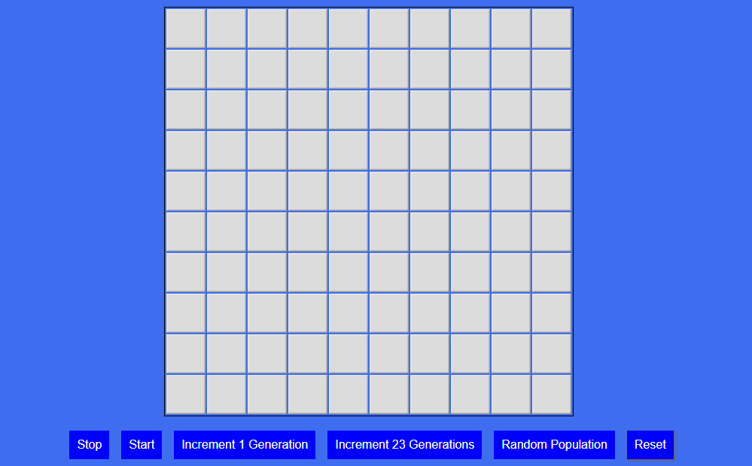
Pattern Grids
Buttons:
1.Stop Game
2. Start Game
3.Increment 1 generation
4.Increment 23 generations
5.Random Population
6.Reset

Slide 4
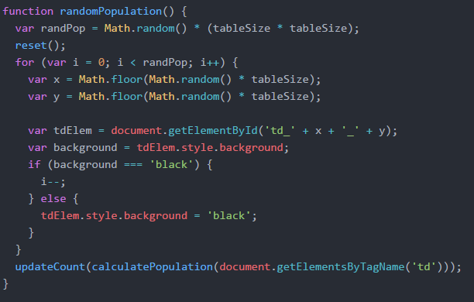
Code snippet
For population and generation

Slide 5
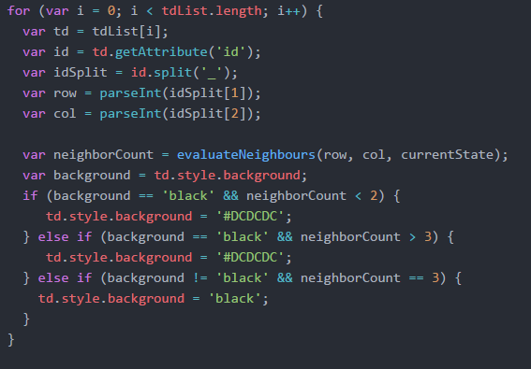
LOGIC

Slide 6
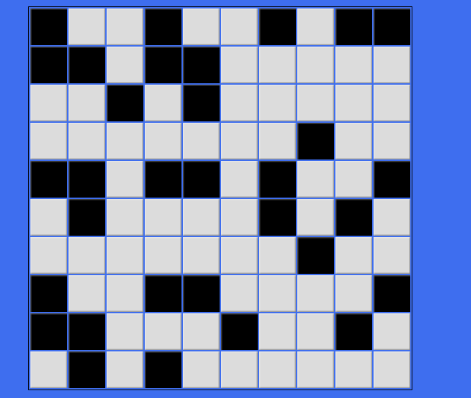
Random Population

Slide 7
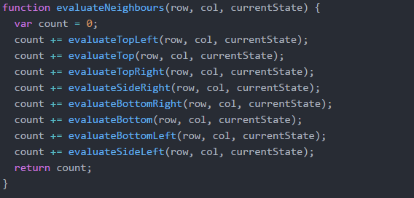
Code snippet

Slide 8
DEMO

